Slide 1
1.30-2.15
Panel discussion:
Geopolitical Risks To Your Portfolio
^{Chaired by}
Matt Gertken Chief Geopolitical/US Political Strategist, BCA Research
Lauren Goodwin
Senior Director, Multi-Asset Solutions,
New York Life Investments
Monica Guerra Executive Director and Head of US Policy,
from Morgan Stanley Wealth Management
Mo Wright Former Civilian Head of US Ground Intelligence

Slide 2
Strategic Engagement Failed
%
%
20
20
IMPORTS (AS A % OF TOTAL)
16
16
US IMPORTS FROM CHINA
EU IMPORTS FROM RUSSIA
12
12
8
8
4
4
2008
2010
2012
2014
2016
2018
2020
2022
2024
NOTE: TRADE DATA IS SMOOTHED USING A 12-MONTH MOVING TOTAL. SOURCE: IMF.

Slide 3
Wars Are Inflationary
CONSUMER PRICE INDEX (REBASED TO 1850 = 100)
8000
8000
UK*
4000
US**
4000
Ukraine War
Iraq
War II
2000
2000
Iraq War I
1000
1000
500
War of Spanish Succession
500
American Civil War
Vietnam War
250
American Revolution
Napoleonic Wars
Second Boer War
250
War of the League of Augsburg
Crimean War
War of Austrian Succession
Seven Years' War
Second World War
100
First World War
100
1675
1700
1725
1750
1775
1800
1825
1850
1875
1900
1925
1950
1975
2000
2025
NOTE: SERIES SHOWN IN LOG SCALE. SHADED REGIONS DENOTE WARS. * SOURCE: BANK OF ENGLAND. ** SOURCE: BUREAU OF LABOR STATISTICS, US.

Slide 4
Geopolitical National Security Highlights
Great Power Competition: Needs increased US defense production; weapons, ammo, vehicles, medical, innovation (space, AI, bio-tech)
GPC: Western Allies remain cohesive, bilateral ties in Asia-Pacific strong, cooperation with Latin America still weak
China: Regaining central influence on world affairs, likely to act to mitigate threats to internal economy
Russia: Short term/limited support from China, Iran, North Korea, but no end in sight to war with Ukraine
Iran: Gaining influence via military rather than economy
Gaza: War will unite Muslim populations, increase Iranian influence
Gaza: Will stress US defense production capabilities, degrade Israeli economic production
Gaza: Oil not as much a weapon as in the ‘73 war

Slide 5
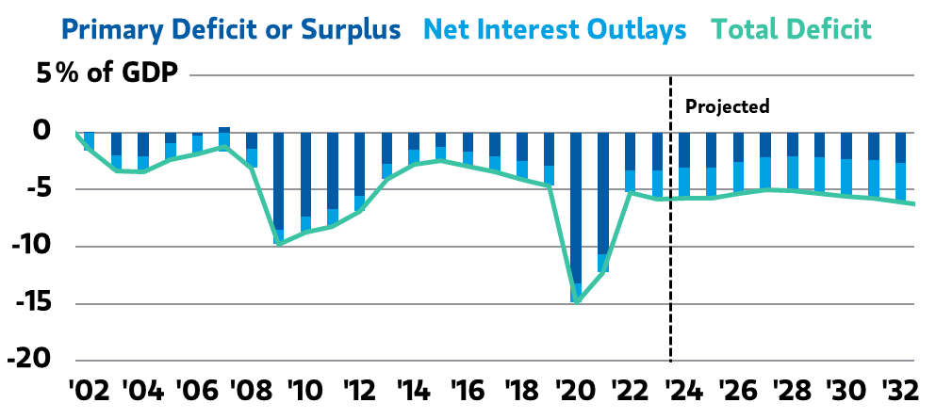
Net interest outlays are projected to rise by the Congressional Budget Office (CBO)
As of October 2023
Source: Congressional Budget Office, Bloomberg, Morgan Stanley Wealth Management Global Investment Office

Slide 6
Applying geopolitical risk to investment practice
Does geopolitical risk really matter for investors? This is typically a function of time horizon.
Investors face tradeoffs between agility and resilience.
Focus on action, not distraction.
LAUREN GOODWIN Head of Multi-Asset Portfolio Strategy New York Life Investments

Slide 7
Thank You!

